Slide 1
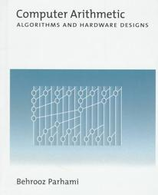
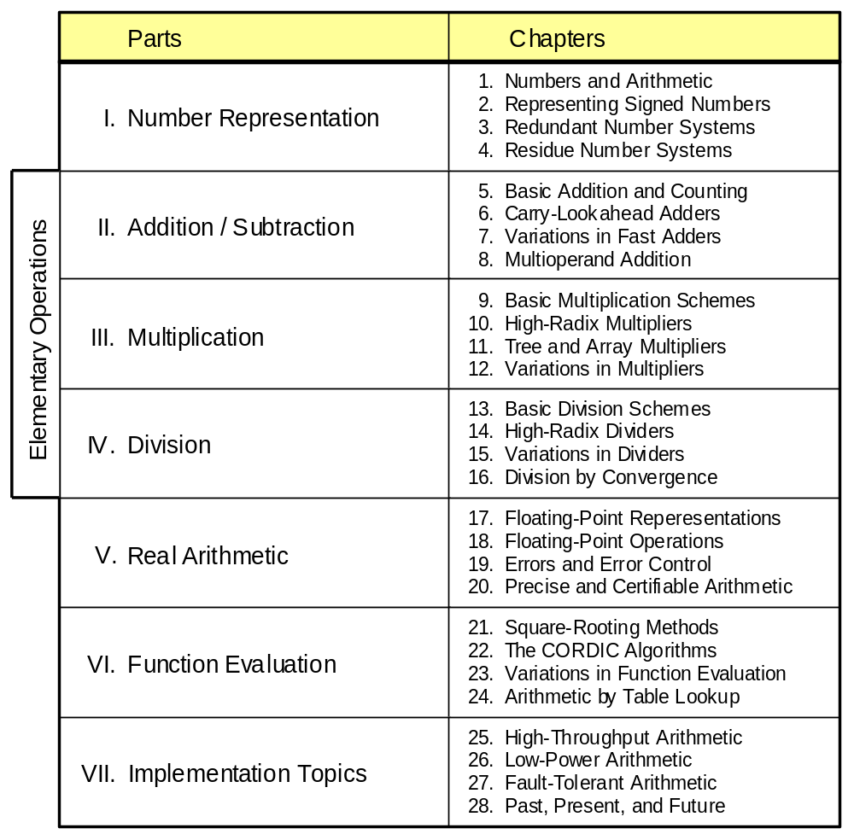
Part VI
Function Evaluation

Slide 2
About This Presentation
This presentation is intended to support the use of the textbook Computer Arithmetic: Algorithms and Hardware Designs (Oxford University Press, 2000, ISBN 0-19-512583-5). It is updated regularly by the author as part of his teaching of the graduate course ECE 252B, Computer Arithmetic, at the University of California, Santa Barbara. Instructors can use these slides freely in classroom teaching and for other educational purposes. Unauthorized uses are strictly prohibited. © Behrooz Parhami
Edition | Released | Revised | Revised | Revised | Revised
First | Jan. 2000 | Sep. 2001 | Sep. 2003 | Oct. 2005 | June 2007

Slide 3
VI Function Evaluation
Learn hardware algorithms for evaluating useful functions
  Divisionlike square-rooting algorithms
  Evaluating sin x, tanh x, ln x, . . . by series expansion
  Function evaluation via convergence computation
  Use of tables: the ultimate in simplicity and flexibility
Topics in This Part
Chapter 21 Square-Rooting Methods
Chapter 22 The CORDIC Algorithms
Chapter 23 Variation in Function Evaluation
Chapter 24 Arithmetic by Table Lookup

Slide 4
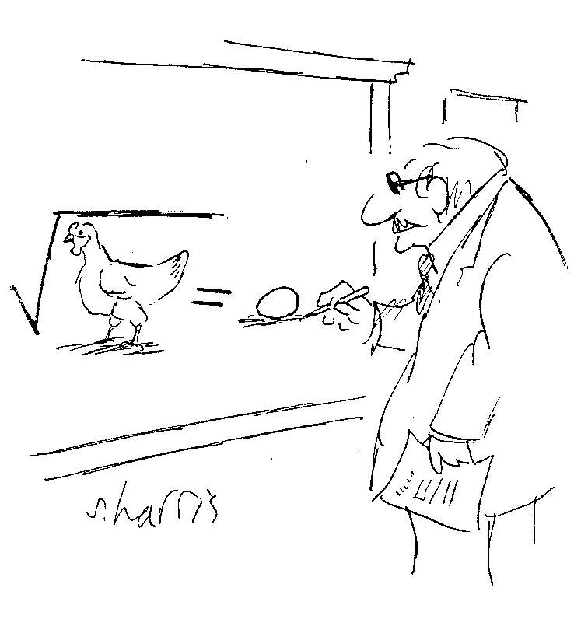


Slide 5
21 Square-Rooting Methods
Chapter Goals
Learning algorithms and implementations
for both digit-at-a-time and convergence
square-rooting
Chapter Highlights
Square-rooting part of ANSI/IEEE standard
Digit-recurrence (divisionlike) algorithms
Convergence or iterative schemes
Square-rooting not special case of division

Slide 6
Square-Rooting Methods: Topics
Topics in This Chapter
21.1. The Pencil-and-Paper Algorithm
21.2. Restoring Shift / Subtract Algorithm
21.3. Binary Nonrestoring Algorithm
21.4. High-Radix Square-Rooting
21.5. Square-Rooting by Convergence
21.6. Parallel Hardware Square-Rooters

Slide 7
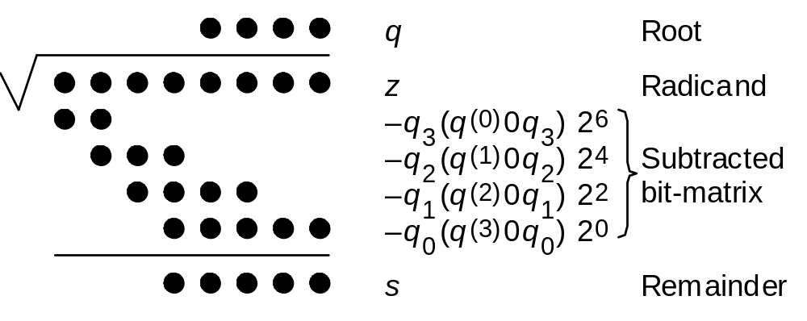
21.1 The Pencil-and-Paper Algorithm
Notation for our discussion of division algorithms:
z Radicand z_{2k–1}z_{2k–2} . . . z₃z₂z₁z₀
q Square root q_{k–1}q_{k–2} . . . q₁q₀
s Remainder, z – q ² s_{k}s_{k–1}s_{k–2} . . . s₁s₀
Remainder range, 0 ≤ s ≤ 2q (k + 1 digits)
Justification: s ≥ 2q + 1 would lead to z = q ² + s ≥ (q + 1)²
Fig. 21.3 Binary square-rooting in dot notation.

Slide 8
Example of Decimal Square-Rooting
Check: 308² + 377 = 94,864 + 377 = 95,241
Root digit
Partial root
q₂ q₁ q₀ ← q q⁽⁰⁾ = 0
−−−−−−−−−−−−−−−−−−−
9 ⏐ 5 2 ⏐ 4 1 ← z q₂ = 3 q⁽¹⁾ = 3
9
−−−−−−−−−
0 5 2 6q₁ × q₁ ≤ 52 q₁ = 0 q⁽²⁾ = 30
0 0
−−−−−−−−−−−−
5 2 4 1 60q₀ × q₀ ≤ 5241 q₀ = 8 q⁽³⁾ = 308
4 8 6 4
−−−−−−−−−−−−
0 3 7 7 ← s = (377)_{ten} q = (308)_{ten}
“sixty plus q₁”
Fig. 21.1 Extracting the square root of a decimal integer using the pencil-and-paper algorithm.

Slide 9
Root Digit Selection Rule
The root thus far is denoted by q ^{(i)} = (q_{k–1}q_{k–2} . . . q_{k–i})_{ten}
Attaching the next digit q_{k–i–1}, partial root becomes q ^{(i+1)} = 10 q ^{(i)} + q_{k–i–1}
The square of q ^{(i+1)} is 100(q ^{(i)})² + 20 q ^{(i)} q_{k–i–1} + (q_{k–i–1})²
100(q ^{(i)})² = (10 q ^{(i)})² subtracted from partial remainder in previous steps
Must subtract (10(2 q ^{(i)} + q_{k–i–1}) × q_{k–i–1} to get the new partial remainder
More generally, in radix r, must subtract (r(2 q ^{(i)}) + q_{k–i–1}) × q_{k–i–1}
In radix 2, must subtract (4 q ^{(i)} + q_{k–i–1}) × q_{k–i–1}, which is
4 q ^{(i)} + 1 for q_{k–i–1} = 1, and 0 otherwise
Thus, we use (q_{k–1}q_{k–2} . . . q_{k–I} 0 1)_{two} in a trial subtraction

Slide 10
Example of Binary Square-Rooting
Check: 10² + 18 = 118 = (0111 0110)_{two}
Root digit
Partial root
q₃ q₂ q₁ q₀ ← q q⁽⁰⁾ = 0
−−−−−−−−−−−−−−−−−−−−−−−
0 1⏐1 1⏐0 1⏐1 0 ≥ 01? Yes q₃ = 1 q⁽¹⁾ = 1
0 1
−−−−−−−−−−−−−−−−−−−−−−−
0 0 1 1 ≥ 101? No q₂ = 0 q⁽²⁾ = 10
0 0 0
−−−−−−−−−−−−−−−−−−−−−−−
0 1 1 0 1 ≥ 1001? Yes q₁ = 1 q⁽³⁾ = 101
1 0 0 1
−−−−−−−−−−−−−−−−−−−−−−−
0 1 0 0 1 0 ≥ 10101? No q₀ = 0 q⁽⁴⁾ = 1010
0 0 0 0 0
−−−−−−−−−−−−−−−−−−−−−−−
1 0 0 1 0 ← s = (18)_{ten} q = (1010)_{two} = (10)_{ten}
Fig. 21.2 Extracting the square root of a binary integer using the pencil-and-paper algorithm.

Slide 11
21.2 Restoring Shift / Subtract Algorithm
Consistent with the ANSI/IEEE floating-point standard, we formulate our algorithms for a radicand in the range 1 ≤ z < 4 (after possible 1-bit shift for an odd exponent)
1 ≤ z < 4 Radicand z₁z₀ . z_{–1}z_{–2} . . . z_{–l}
1 ≤ q < 2 Square root 1 . q_{–1}q_{–2} . . . q_{–l}
0 ≤ s < 4 Remainder s₁ s₀ . s_{–1} s_{–2} . . . s_{–l}
Binary square-rooting is defined by the recurrence
s ^{(j)} = 2s ^{(j–1)} – q_{–j}(2q ^{(j–1)} + 2^{–j} q_{–j}) with s ⁽⁰⁾ = z – 1, q ⁽⁰⁾ = 1, s ^{(j)} = s
where q ^{(j)} is the root up to its (–j)th digit; thus q = q ^{(l)}
To choose the next root digit q_{–j} ∈ {0, 1}, subtract from 2s ^{(j–1)} the value
2q ^{(j–1)} + 2^{–j} = (1 q₋₁^{(j–1)} . q₋₂^{(j–1)} . . . q_{−j+1}^{(j–1)} 0 1)_{two}
A negative trial difference means q_{–j} = 0

Slide 12
Finding the Sq. Root of z = 1.110110 via the Restoring Algorithm
Root digit
Partial root
================================
z (radicand = 118/64) 0 1 . 1 1 0 1 1 0
================================
s⁽⁰⁾ = z – 1 0 0 0 . 1 1 0 1 1 0 q₀ = 1 1.
2s⁽⁰⁾ 0 0 1 . 1 0 1 1 0 0
–[2 × (1.)+2^{–1}] 1 0 . 1
–––––––––––––––––––––––––––––––––
s⁽¹⁾ 1 1 1 . 0 0 1 1 0 0 q_{–1} = 0 1.0
s⁽¹⁾ = 2s⁽⁰⁾ Restore 0 0 1 . 1 0 1 1 0 0
2s⁽¹⁾ 0 1 1 . 0 1 1 0 0 0
–[2 × (1.0)+2^{–2}] 1 0 . 0 1
–––––––––––––––––––––––––––––––––
s⁽²⁾ 0 0 1 . 0 0 1 0 0 0 q_{–2} = 1 1.01
2s⁽²⁾ 0 1 0 . 0 1 0 0 0 0
–[2 × (1.01)+2^{–3}] 1 0 . 1 0 1
–––––––––––––––––––––––––––––––––
s⁽³⁾ 1 1 1 . 1 0 1 0 0 0 q_{–3} = 0 1.010
s⁽³⁾ = 2s⁽²⁾ Restore 0 1 0 . 0 1 0 0 0 0
2s(3) 1 0 0 . 1 0 0 0 0 0
–[2 × (1.010)+2^{–4}] 1 0 . 1 0 0 1
–––––––––––––––––––––––––––––––––
s⁽⁴⁾ 0 0 1 . 1 1 1 1 0 0 q_{–4} = 1 1.0101
2s⁽⁴⁾ 0 1 1 . 1 1 1 0 0 0
–[2 × (1.0101)+2^{–5}] 1 0 . 1 0 1 0 1
–––––––––––––––––––––––––––––––––
s⁽⁵⁾ 0 0 1 . 0 0 1 1 1 0 q_{–5} = 1 1.01011
2s⁽⁵⁾ 0 1 0 . 0 1 1 1 0 0
–[2×(1.01011)+2^{–6}] 1 0 . 1 0 1 1 0 1
–––––––––––––––––––––––––––––––––
s⁽⁶⁾ 1 1 1 . 1 0 1 1 1 1 q_{–6} = 0 1.010110
s⁽⁶⁾ = 2s⁽⁵⁾ Restore 0 1 0 . 0 1 1 1 0 0
s (remainder = 156/64) 0 . 0 0 0 0 1 0 0 1 1 1 0 0
q (root = 86/64) 1 . 0 1 0 1 1 0
================================
Fig. 21.4 Example of sequential binary
square-rooting using the restoring algorithm.
q_{–7} = 1, so round up

Slide 13
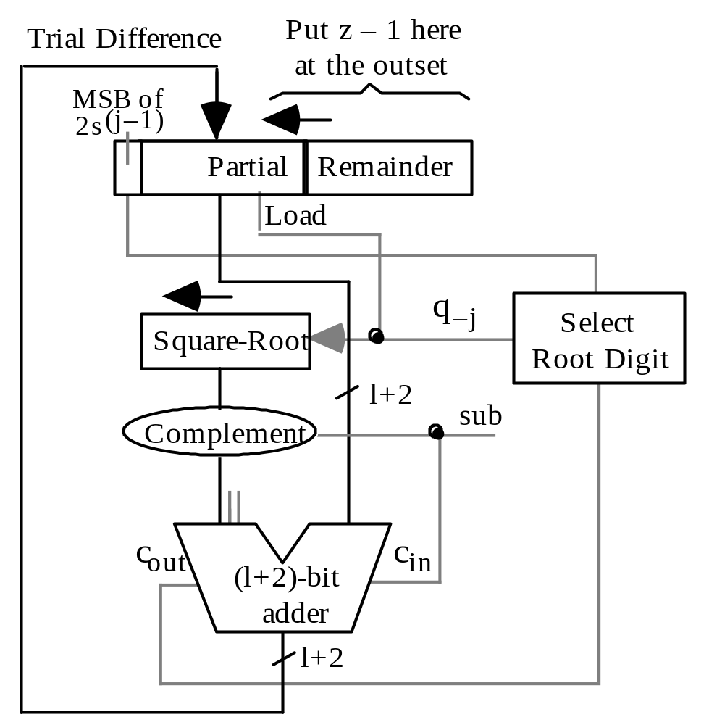
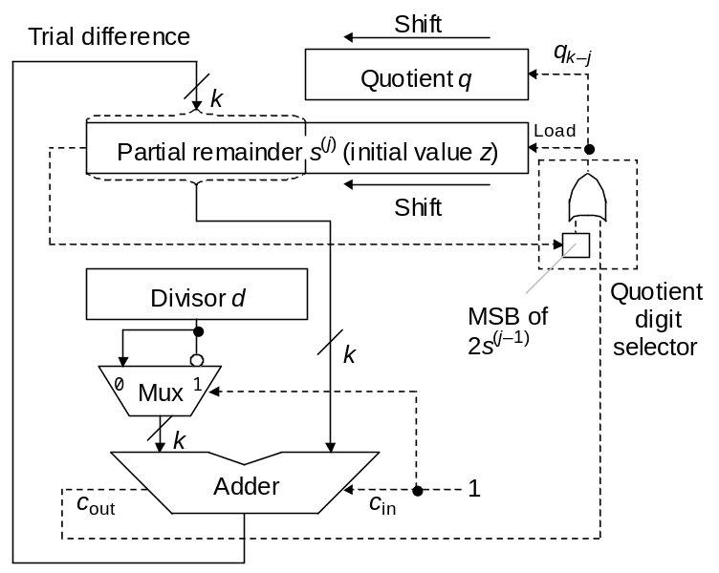
Hardware for Restoring Square-Rooting
Fig. 13.5 Shift/subtract sequential restoring divider (for comparison).
Fig. 21.5 Sequential shift/subtract restoring square-rooter.

Slide 14
Rounding the Square Root
In fractional square-rooting, the remainder is not needed
To round the result, we can produce an extra digit q_{–l–1}:
Truncate for q_{–l–1} = 0, round up for q_{–l–1} = 1
Midway case, q_{–l–1} = 1 followed by all 0s, impossible (Prob. 21.11)
Example: In Fig. 21.4, we had
(01.110110)_{two} = (1.010110)_{two}² + (10.011100)/64
An extra iteration produces q_{–7} = 1
So the root is rounded up to q = (1.010111)_{two} = 87/64
The rounded-up value is closer to the root than the truncated version
Original: 118/64 = (86/64)² + 156/(64)²
Rounded: 118/64 = (87/64)² – 17/(64)²

Slide 15
21.3 Binary Nonrestoring Algorithm
As in nonrestoring division, nonrestoring square-rooting implies:
Root digits in {⁻1, 1}
On-the-fly conversion to binary
Possible final correction
The case q_{–j} = 1 (nonnegative partial remainder), is handled as in the restoring algorithm; i.e., it leads to the trial subtraction of
q_{–j} [2q ^{(j–1)} + 2^{–j} q_{–j} ] = 2q ^{(j–1)} + 2^{–j}
For q_{–j} = ⁻1, we must subtract
q_{–j} [2q ^{(j–1)} + 2^{–j} q_{–j} ] = – [2q ^{(j–1)} – 2^{–j} ]
which is equivalent to adding 2q ^{(j–1)} – 2^{–j}
Slight complication, compared with nonrestoring division
This term cannot be formed by concatenation

Slide 16
Finding the Sq. Root of z = 1.110110 via the Nonrestoring Algorithm
================================
z (radicand = 118/64) 0 1 . 1 1 0 1 1 0
================================
s⁽⁰⁾ = z – 1 0 0 0 . 1 1 0 1 1 0 q₀ = 1 1.
2s⁽⁰⁾ 0 0 1 . 1 0 1 1 0 0 q_{–1} = 1 1.1
–[2 × (1.)+2^{–1}] 1 0 . 1
–––––––––––––––––––––––––––––––––
s⁽¹⁾ 1 1 1 . 0 0 1 1 0 0 q_{–2} = ⁻1 1.01
2s⁽¹⁾ 1 1 0 . 0 1 1 0 0 0
+[2 × (1.1)−2^{–2}] 1 0 . 1 1
–––––––––––––––––––––––––––––––––
s⁽²⁾ 0 0 1 . 0 0 1 0 0 0 q_{–3} = 1 1.011
2s⁽²⁾ 0 1 0 . 0 1 0 0 0 0
–[2 × (1.01)+2^{–3}] 1 0 . 1 0 1
–––––––––––––––––––––––––––––––––
s⁽³⁾ 1 1 1 . 1 0 1 0 0 0 q_{–4} = ⁻1 1.0101
2s(3) 1 1 1 . 0 1 0 0 0 0
+[2 × (1.011)−2^{–4}] 1 0 . 1 0 1 1
–––––––––––––––––––––––––––––––––
s⁽⁴⁾ 0 0 1 . 1 1 1 1 0 0 q_{–5} = 1 1.01011
2s⁽⁴⁾ 0 1 1 . 1 1 1 0 0 0
–[2 × (1.0101)+2^{–5}] 1 0 . 1 0 1 0 1
–––––––––––––––––––––––––––––––––
s⁽⁵⁾ 0 0 1 . 0 0 1 1 1 0 q_{–6} = 1 1.010111
2s⁽⁵⁾ 0 1 0 . 0 1 1 1 0 0
–[2×(1.01011)+2^{–6}] 1 0 . 1 0 1 1 0 1
–––––––––––––––––––––––––––––––––
s⁽⁶⁾ 1 1 1 . 1 0 1 1 1 1 Negative; (−17/64)
+[2×(1.01011)−2^{–6}] 1 0 . 1 0 1 1 0 1 Correct
–––––––––––––––––––––––––––––––––
s⁽⁶⁾ Corrected 0 1 0 . 0 1 1 1 0 0 (156/64)
s (remainder = 156/64) 0 . 0 0 0 0 1 0 0 1 1 1 0 0 (156/64²)
q (binary) 1 . 0 1 0 1 1 1 (87/64)
q (corrected binary) 1 . 0 1 0 1 1 0 (86/64)
================================
Root digit
Partial root
Fig. 21.6 Example of nonrestoring binary
square-rooting.

Slide 17
Some Details for Nonrestoring Square-Rooting
Depending on the sign of the partial remainder, add:
(positive) Add 2q ^{(j–1)} + 2^{–j}
(negative) Sub. 2q ^{(j–1)} – 2^{–j}
Concatenate 01 to the end of q ^{(j–1)}
Cannot be formed by concatenation
Solution: We keep q ^{(j–1)} and q ^{(j–1)} – 2^{–j+1} in registers Q (partial root) and Q* (diminished partial root), respectively. Then:
q_{–j} = 1 Subtract 2q ^{(j–1)} + 2^{–j} formed by shifting Q 01
q_{–j} = ⁻1 Add 2q ^{(j–1)} – 2^{–j} formed by shifting Q*11
Updating rules for Q and Q* registers:
q_{–j} = 1 ⇒ Q := Q 1 Q* := Q 0
q_{–j} = ⁻1 ⇒ Q := Q*1 Q* := Q*0
Additional rule for SRT-like algorithm that allow q_{–j} = 0 as well:
q_{–j} = 0 ⇒ Q := Q 0 Q* := Q*1

Slide 18
21.4 High-Radix Square-Rooting
Basic recurrence for fractional radix-r square-rooting:
s ^{(j)} = rs ^{(j–1)} – q_{–j}(2 q ^{(j–1)} + r ^{–j} q_{–j})
As in radix-2 nonrestoring algorithm, we can use two registers Q and Q* to hold q ^{(j–1)} and its diminished version q ^{(j–1)} – r ^{–j+1}, respectively, suitably updating them in each step
Fig. 21.3
Radix-4 square-rooting in dot notation

Slide 19
An Implementation of Radix-4 Square-Rooting
s ^{(j)} = rs ^{(j–1)} – q_{–j}(2 q ^{(j–1)} + r ^{–j} q_{–j})
r = 4, root digit set [–2, 2]
Q* holds q ^{(j–1)} – 4^{–j+1} = q ^{(j–1)} – 2^{–2j+2}. Then, one of the following values must be subtracted from, or added to, the shifted partial remainder rs ^{(j–1)}
q_{–j} = 2 Subtract 4q ^{(j–1)} + 2^{–2j+2} double-shift Q 010
q_{–j} = 1 Subtract 2q ^{(j–1)} + 2^{–2j} shift Q 001
q_{–j} = ⁻1 Add 2q ^{(j–1)} – 2^{–2j} shift Q*111
q_{–j} = ⁻2 Add 4q ^{(j–1)} – 2^{–2j+2} double-shift Q*110
Updating rules for Q and Q* registers:
q_{–j} = 2 ⇒ Q := Q 10 Q* := Q 01
q_{–j} = 1 ⇒ Q := Q 01 Q* := Q 00
q_{–j} = 0 ⇒ Q := Q 00 Q* := Q*11
q_{–j} = ⁻1 ⇒ Q := Q*11 Q* := Q*10
q_{–j} = ⁻2 ⇒ Q := Q*10 Q* := Q*01
Note that the root is obtained in binary form (no conversion needed!)

Slide 20
Keeping the Partial Remainder in Carry-Save Form
As in fast division, root digit selection can be based on a few bits of the shifted partial remainder 4s ^{(j–1)} and of the partial root q ^{(j–1)}
This would allow us to keep s in carry-save form
One extra bit of each component of s (sum and carry) must be examined
Can use the same lookup table for quotient digit and root digit selection
To see how, compare recurrences for radix-4 division and square-rooting:
Division: s ^{(j)} = 4s ^{(j–1)} – q_{–j} d
Square-rooting: s ^{(j)} = 4s ^{(j–1)} – q_{–j} (2 q ^{(j–1)} + 4 ^{–j} q_{–j})
To keep magnitudes of partial remainders for division and square-rooting comparable, we can perform radix-4 square-rooting using the digit set
{−1, −½ , 0 , ½ , 1}
Can convert from the digit set above to the digit set [–2, 2], or directly to binary, with no extra computation

Slide 21
21.5 Square-Rooting by Convergence
Newton-Raphson method
Choose f(x) = x² – z with a root at x = √z
x ^{(i+1)} = x ^{(i)} – f(x ^{(i)}) / f ′(x ^{(i)})
x ^{(i+1)} = 0.5(x ^{(i)} + z / x ^{(i)})
Each iteration: division, addition, 1-bit shift
Convergence is quadratic
f(x)
x
√z
−z
For 0.5 ≤ z < 1, a good starting approximation is (1 + z)/2
This approximation needs no arithmetic
The error is 0 at z = 1 and has a max of 6.07% at z = 0.5
The hardware approximation method of Schwarz and Flynn, using the tree circuit of a fast multiplier, can provide a much better approximation (e.g., to 16 bits, needing only two iterations for 64 bits of precision)

Slide 22
Initial Approximation Using Table Lookup
Table-lookup can yield a better starting estimate x ⁽⁰⁾ for √z
For example, with an initial estimate accurate to within 2^{–8}, three iterations suffice to increase the accuracy of the root to 64 bits
x ^{(i+1)} = 0.5(x ^{(i)} + z / x ^{(i)})
Example 21.1: Compute the square root of z = (2.4)_{ten}
x ⁽⁰⁾ read out from table = 1.5 accurate to 10^{–1}
x ⁽¹⁾ = 0.5(x ⁽⁰⁾ + 2.4 / x ⁽⁰⁾) = 1.550 000 000 accurate to 10^{–2}
x ⁽²⁾ = 0.5(x ⁽¹⁾ + 2.4 / x ⁽¹⁾) = 1.549 193 548 accurate to 10^{–4}
x ⁽³⁾ = 0.5(x ⁽²⁾ + 2.4 / x ⁽²⁾) = 1.549 193 338 accurate to 10^{–8}
Check: (1.549 193 338)² = 2.399 999 999

Slide 23
Convergence Square-Rooting without Division
x ^{(i+1)} = 0.5(x ^{(i)} + z / x ^{(i)})
Rewrite the square-root recurrence as:
x ^{(i+1)} = x ^{(i)} + 0.5 (1/x ^{(i)})(z – (x ^{(i)})²) = x ^{(i)} + 0.5γ(x ^{(i)})(z – (x ^{(i)})²)
where γ(x ^{(i)}) is an approximation to 1/x ^{(i)} obtained by a simple circuit or read out from a table
Because of the approximation used in lieu of the exact value of 1/x ^{(i)}, convergence rate will be less than quadratic
Alternative: Use the recurrence above, but find the reciprocal iteratively; thus interlacing the two computations
Using the function f(y) = 1/y – x to compute 1/x, we get:
x ^{(i+1)} = 0.5(x ^{(i)} + z y ^{(i)})
y ^{(i+1)} = y ^{(i)} (2 – x ^{(i)} y ^{(i)})
Convergence is less than quadratic but better than linear
3 multiplications, 2 additions, and a 1-bit shift per iteration

Slide 24
Example for Division-Free Square-Rooting
x ^{(i+1)} = 0.5(x ^{(i)} + z y ^{(i)})
y ^{(i+1)} = y ^{(i)} (2 – x ^{(i)} y ^{(i)})
x converges to √z
y converges to 1/√z
Example 21.2: Compute √1.4, beginning with x ⁽⁰⁾ = y ⁽⁰⁾ = 1
x ⁽¹⁾ = 0.5(x ⁽⁰⁾ + 1.4 y ⁽⁰⁾) = 1.200 000 000
y ⁽¹⁾ = y ⁽⁰⁾ (2 – x ⁽⁰⁾ y ⁽⁰⁾) = 1.000 000 000
x ⁽²⁾ = 0.5(x ⁽¹⁾ + 1.4 y ⁽¹⁾) = 1.300 000 000
y ⁽²⁾ = y ⁽¹⁾ (2 – x ⁽¹⁾ y ⁽¹⁾) = 0.800 000 000
x ⁽³⁾ = 0.5(x ⁽²⁾ + 1.4 y ⁽²⁾) = 1.210 000 000
y ⁽³⁾ = y ⁽²⁾ (2 – x ⁽²⁾ y ⁽²⁾) = 0.768 000 000
x ⁽⁴⁾ = 0.5(x ⁽³⁾ + 1.4 y ⁽³⁾) = 1.142 600 000
y ⁽⁴⁾ = y ⁽³⁾ (2 – x ⁽³⁾ y ⁽³⁾) = 0.822 312 960
x ⁽⁵⁾ = 0.5(x ⁽⁴⁾ + 1.4 y ⁽⁴⁾) = 1.146 919 072
y ⁽⁵⁾ = y ⁽⁴⁾ (2 – x ⁽⁴⁾ y ⁽⁴⁾) = 0.872 001 394
x ⁽⁶⁾ = 0.5(x ⁽⁵⁾ + 1.4 y ⁽⁵⁾) = 1.183 860 512 ≅ √1.4
Check: (1.183 860 512)² = 1.401 525 712

Slide 25
Another Division-Free Convergence Scheme
Based on computing 1/√z, which is then multiplied by z to obtain √z
The function f(x) = 1/x² – z has a root at x = 1/√z (f ′(x) = –2/x³)
x ^{(i+1)} = 0.5 x ^{(i)} (3 – z (x ^{(i)})²)
Quadratic convergence
3 multiplications, 1 addition, and a 1-bit shift per iteration
Example 21.3: Compute the square root of z = (.5678)_{ten}
x ⁽⁰⁾ read out from table = 1.3
x ⁽¹⁾ = 0.5x ⁽⁰⁾ (3 – 0.5678 (x ⁽⁰⁾)²) = 1.326 271 700
x ⁽²⁾ = 0.5x ⁽¹⁾ (3 – 0.5678 (x ⁽¹⁾)²) = 1.327 095 128
√z ≅ z × x ⁽²⁾ = 0.753 524 613
Cray 2 supercomputer used this method. Initially, instead of x ⁽⁰⁾, the two values 1.5 x ⁽⁰⁾ and 0.5(x ⁽⁰⁾)³ are read out from a table, requiring only 1 multiplication in the first iteration. The value x ⁽¹⁾ thus obtained is accurate to within half the machine precision, so only one other iteration is needed (in all, 5 multiplications, 2 additions, 2 shifts)

Slide 26
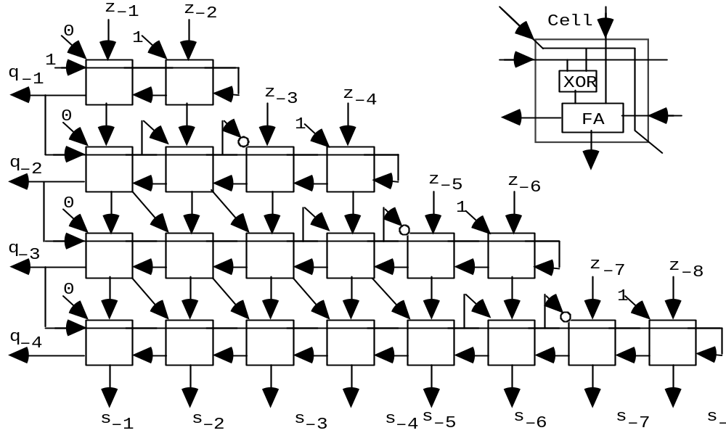
21.6 Parallel Hardware Square-Rooters
Array square-rooters can be derived from the dot-notation representation in much the same way as array dividers
Fig. 21.7 Nonrestoring array square-rooter built of controlled add/subtract cells.

Slide 27
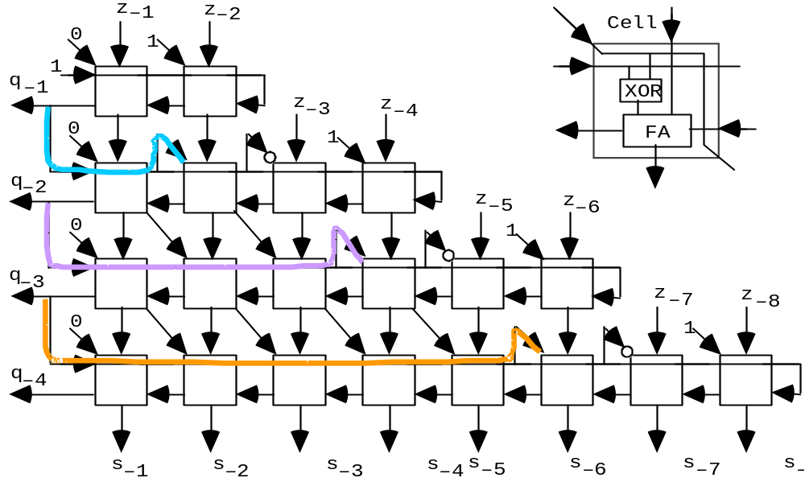
Understanding the Array Square-Rooter Design
Description goes here

Slide 28
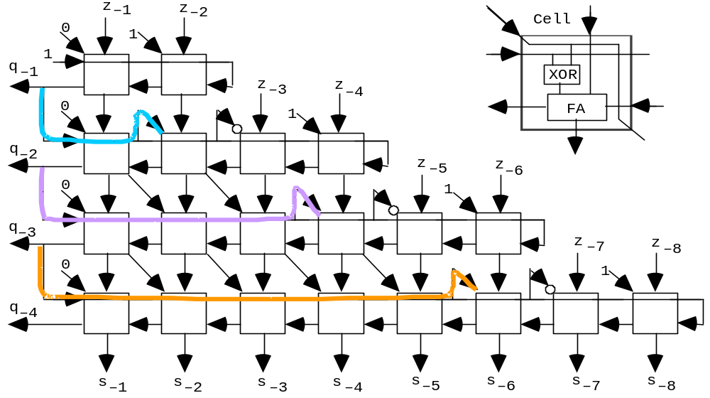
Nonrestoring Array Square-Rooter in Action
0
1
0
1
1
1
0
1
0
0
1
1
0
1
0
1
1
0
1
1
0
1
1
1
0
0
1
0
0
1
0
1
1
0
1
1
0
1
1
1
0
0
0
1
0
0
1
0
0
0
0
1
0
1
0
1
1
0
0
0
0
0
1
0
0
1
1
1
1
1
1
0
1
Check: 118/256 = (10/16)² + (−3/256)? Note that the answer is
approximate (to within 1 ulp) due to there being no final correction

Slide 29
Digit-at-a-Time Version of the Previous Example
================================
z = 118/256 . 0 1 1 1 0 1 1 0
================================
s ⁽⁰⁾ = z 0 0 . 0 1 1 1 0 1 1 0
2s ⁽⁰⁾ 0 0 0 . 1 1 1 0 1 1 0
–(2q + 2^{–1}) 1 1 . 1
–––––––––––––––––––––––––––––––––––
s ⁽¹⁾ 0 0 . 0 1 1 0 1 1 0 q_{–1} = 1 q = .1
2s ⁽¹⁾ 0 0 0 . 1 1 0 1 1 0
–(2q + 2^{–2}) 1 0 . 1 1
–––––––––––––––––––––––––––––––––––
s ⁽²⁾ 1 1 . 1 0 0 1 1 0 q_{–2} = 0 q = .10
2s ⁽²⁾ 1 1 1 . 0 0 1 1 0
+(2q – 2^{–3}) 0 0 . 1 1 1
–––––––––––––––––––––––––––––––––––
s ⁽³⁾ 0 0 . 0 0 0 1 0 q_{–3} = 1 q =.101
2s ⁽³⁾ 0 0 0 . 0 0 1 0
–(2q + 2^{–4}) 1 0 . 1 0 1 1
–––––––––––––––––––––––––––––––––––
s ⁽⁴⁾ 1 0 . 1 1 0 1 q_{–4} = 0 q = .1010
=================================
In this example, z is ¼ of that in Fig. 21.6. Subtraction (addition) uses the term 2q + 2^{–i} (2q – 2^{–i}).
Root digit
Partial root

Slide 30
22 The CORDIC Algorithms
Chapter Goals
Learning a useful convergence method for
evaluating trigonometric and other functions
Chapter Highlights
Basic CORDIC idea: rotate a vector with
end point at (x,y) = (1,0) by the angle z
to put its end point at (cos z, sin z)
Other functions evaluated similarly
Complexity comparable to division

Slide 31
The CORDIC Algorithms: Topics
Topics in This Chapter
22.1. Rotations and Pseudorotations
22.2. Basic CORDIC Iterations
22.3. CORDIC Hardware
22.4. Generalized CORDIC
22.5. Using the CORDIC Method
22.6. An Algebraic Formulation

Slide 32
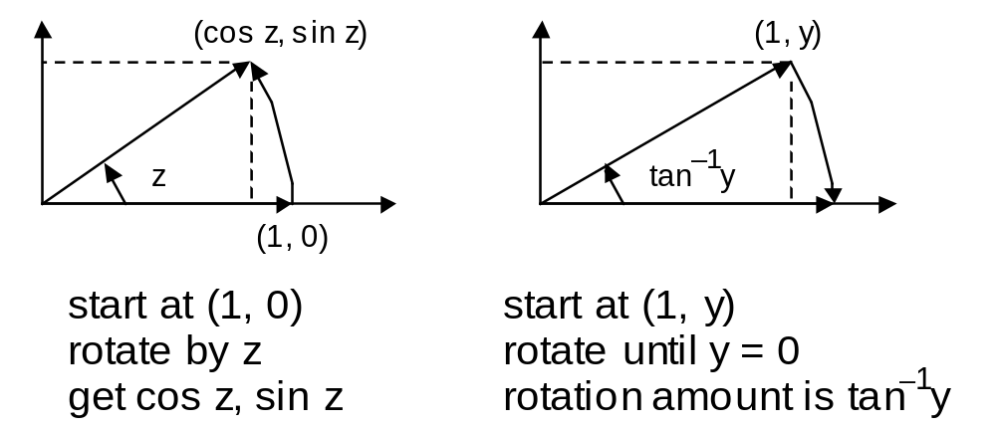
22.1 Rotations and Pseudorotations
Key ideas in CORDIC
COordinate Rotation DIgital Computer used this method in 1950s; modern electronic calculators also use it
If we have a computationally efficient way of rotating a vector, we can evaluate cos, sin, and tan^{–1} functions
Rotation by an arbitrary angle is difficult, so we:
Perform psuedorotations that require simpler operations
Use special angles to synthesize the desired angle z
z = α ⁽¹⁾ + α ⁽²⁾ + . . . + α ^{(m)}
-

Slide 33
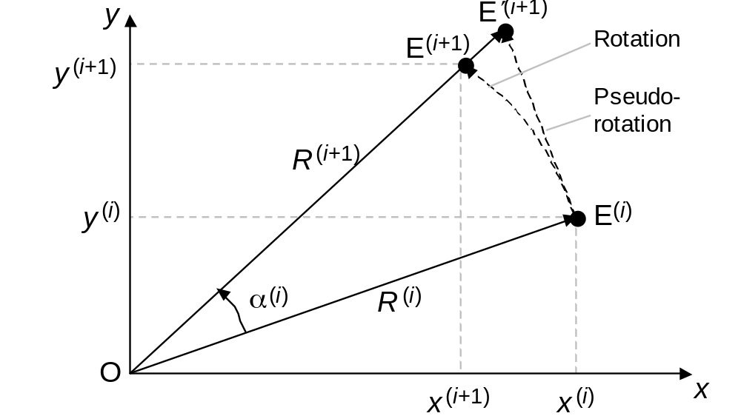
Rotating a Vector (x ^{(i)}, y ^{(i)}) by the Angle α ^{(i)}
x^{(i+1)} = x^{(i)} cos α^{(i)} – y^{(i)} sin α^{(i)} = (x^{(i)} – y^{(i)} tan α^{(i)}) / (1 + tan² α^{(i)})^{1/2}
y^{(i+1)} = y^{(i)} cos α^{(i)} + x^{(i)} sin α^{(i)} = (y^{(i)} + x^{(i)} tan α^{(i)}) / (1 + tan² α^{(i)})^{1/2}
z^{(i+1)} = z^{(i)} – α^{(i)}
Recall that cos θ = 1 / (1 + tan² θ)^{1/2}
Our strategy: Eliminate the terms (1 + tan² α^{(i)})^{1/2} and choose the angles α^{(i)}) so that tan α^{(i)} is a power of 2; need two shift-adds
Fig. 22.1 A pseudorotation step in CORDIC

Slide 34
Pseudorotating a Vector (x ^{(i)}, y ^{(i)}) by the Angle α ^{(i)}
x^{(i+1)} = x^{(i)} – y^{(i)} tan α^{(i)}
y^{(i+1)} = y^{(i)} + x^{(i)} tan α^{(i)}
z^{(i+1)} = z^{(i)} – α^{(i)}
Pseudorotation: Whereas a real rotation
does not change the length R(i) of the vector,
a pseudorotation step increases its length to:
R^{(i+1)} = R^{(i)} / cos α^{(i)} = R^{(i)} (1 + tan² α^{(i)})^{1/2}
Fig. 22.1 A pseudorotation step in CORDIC

Slide 35
A Sequence of Rotations or Pseudorotations
x^{(m)} = x cos(∑α^{(i)}) – y sin(∑α^{(i)})
x^{(m)} = y cos(∑α^{(i)}) + x sin(∑α^{(i)})
z^{(m)} = z – (∑α^{(i)})
After m real rotations by
α⁽¹⁾, α⁽²⁾ , . . . , α^{(m)} , given x⁽⁰⁾ = x, y⁽⁰⁾ = y, and z⁽⁰⁾ = z
x^{(m)} = K(x cos(∑α^{(i)}) – y sin(∑α^{(i)}))
y^{(m)} = K(y cos(∑α^{(i)}) + x sin(∑α^{(i)}))
z^{(m)} = z – (∑α^{(i)})
where K = ∏(1 + tan² α^{(i)})^{1/2} is
a constant if angles of rotation
are always the same, differing
only in sign or direction
After m pseudorotations by
α⁽¹⁾, α⁽²⁾ , . . . , α^{(m)} , given x⁽⁰⁾ = x, y⁽⁰⁾ = y, and z⁽⁰⁾ = z
α⁽³⁾
α⁽²⁾
Question: Can we find a set of angles so that any angle can be synthesized from all of them with appropriate signs?
α⁽¹⁾

Slide 36
22.2 Basic CORDIC Iterations
x^{(i+1)} = x^{(i)} – d_{i} y^{(i)} 2^{–i}
y^{(i+1)} = y^{(i)} + d_{i} x^{(i)} 2^{–i}
z^{(i+1)} = z^{(i)} – d_{i} tan ^{–1} 2^{–i}
= z^{(i)} – d_{i} e^{(i)}
CORDIC iteration: In step i, we pseudorotate by an angle whose tangent is d_{i} 2^{–i} (the angle e^{(i)} is fixed, only direction d_{i} is to be picked)
––––––––––––––––––––––––––––––––
i
––––––––––––––––––––––––––––––––
0 45.0 0.785 398 163
1 26.6 0.463 647 609
2 14.0 0.244 978 663
3 7.1 0.124 354 994
4 3.6 0.062 418 810
5 1.8 0.031 239 833
6 0.9 0.015 623 728
7 0.4 0.007 812 341
8 0.2 0.003 906 230
9 0.1 0.001 953 123
––––––––––––––––––––––––––––––––
e^{(i)} in degrees
(approximate)
e^{(i)} in radians
(precise)
Table 22.1 Value of
the function e^{(i)} = tan ^{–1} 2^{–i},
in degrees and radians, for 0 ≤ i ≤ 9
Example: 30° angle
30.0 ≅ 45.0 – 26.6 + 14.0
– 7.1 + 3.6 + 1.8
– 0.9 + 0.4 – 0.2
+ 0.1
= 30.1

Slide 37
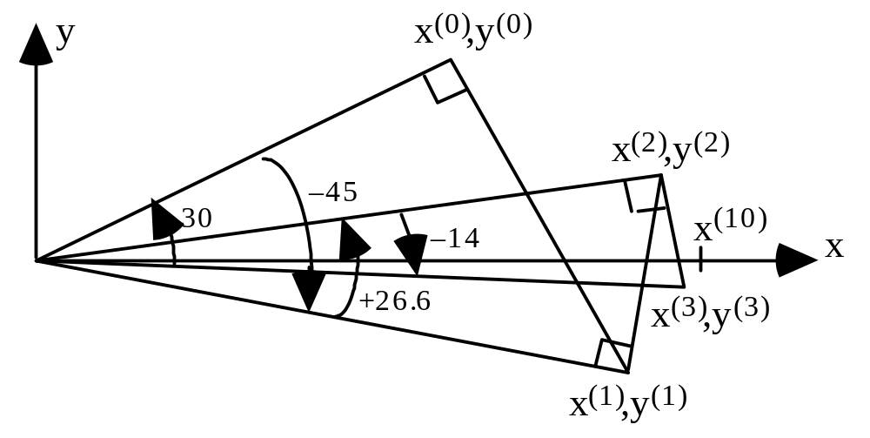
Choosing the Angles to Force z to Zero
x^{(i+1)} = x^{(i)} – d_{i} y^{(i)} 2^{–i}
y^{(i+1)} = y^{(i)} + d_{i} x^{(i)} 2^{–i}
z^{(i+1)} = z^{(i)} – d_{i} tan ^{–1} 2^{–i}
= z^{(i)} – d_{i} e^{(i)}
–––––––––––––––––––––––––––––––
i z^{(i)} – d_{i} e^{(i)} = z^{(i+1)}
–––––––––––––––––––––––––––––––
+30.0
0 +30.0 – 45.0 = –15.0
1 –15.0 + 26.6 = +11.6
2 +11.6 – 14.0 = –2.4
3 –2.4 + 7.1 = +4.7
4 +4.7 – 3.6 = +1.1
5 +1.1 – 1.8 = –0.7
6 –0.7 + 0.9 = +0.2
7 +0.2 – 0.4 = –0.2
8 –0.2 + 0.2 = +0.0
9 +0.0 – 0.1 = –0.1
–––––––––––––––––––––––––––––––
Fig. 22.2 The first three of 10 pseudorotations leading from (x⁽⁰⁾, y⁽⁰⁾) to (x⁽¹⁰⁾, 0) in rotating by +30°.
Table 22.2 Choosing the signs of the rotation angles in order to force z to 0

Slide 38
Why Any Angle Can Be Formed from Our List
Analogy: Paying a certain amount while using all currency denominations (in positive or negative direction) exactly once; red values are fictitious.
$20 $10 $5 $3 $2 $1 $.50 $.25 $.20 $.10 $.05 $.03 $.02 $.01
Example: Pay $12.50
$20 – $10 + $5 – $3 + $2 – $1 – $.50 + $.25 – $.20 – $.10 + $.05 + $.03 – $.02 – $.01
Convergence is possible as long as each denomination is no greater than the sum of all denominations that follow it.
Domain of convergence: –$42.16 to +$42.16
We can guarantee convergence with actual denominations if we allow multiple steps at some values:
$20 $10 $5 $2 $2 $1 $.50 $.25 $.10 $.10 $.05 $.01 $.01 $.01 $.01
Example: Pay $12.50
$20 – $10 + $5 – $2 – $2 + $1 + $.50+$.25–$.10–$.10–$.05+$.01–$.01+ $.01–$.01
We will see later that in hyperbolic CORDIC, convergence is guaranteed only if certain “angles” are used twice.

Slide 39
Using CORDIC in Rotation Mode
0
x^{(i+1)} = x^{(i)} – d_{i} y^{(i)} 2^{–i}
y^{(i+1)} = y^{(i)} + d_{i} x^{(i)} 2^{–i}
z^{(i+1)} = z^{(i)} – d_{i} tan ^{–1} 2^{–i}
= z^{(i)} – d_{i} e^{(i)}
x^{(m)} = K(x cos z – y sin z)
y^{(m)} = K(y cos z + x sin z)
z^{(m)} = 0
where K = 1.646 760 258 121 . . .
Make z converge to 0 by choosing d_{i} = sign(z^{(i)})
0
Start with
x = 1/K = 0.607 252 935 . . .
and y = 0
to find cos z and sin z
For k bits of precision in results,
k CORDIC iterations are needed, because tan ^{–1} 2^{–i} ≅ 2^{–I} for large i
Convergence of z to 0 is possible because each of the angles in our list is more than half the previous one or, equivalently, each is less than the sum of all the angles that follow it
Domain of convergence is –99.7˚ ≤ z ≤ 99.7˚, where 99.7˚ is the sum of all the angles in our list; the domain contains [–π/2, π/2] radians

Slide 40
Using CORDIC in Vectoring Mode
x^{(i+1)} = x^{(i)} – d_{i} y^{(i)} 2^{–i}
y^{(i+1)} = y^{(i)} + d_{i} x^{(i)} 2^{–i}
z^{(i+1)} = z^{(i)} – d_{i} tan ^{–1} 2^{–i}
= z^{(i)} – d_{i} e^{(i)}
x^{(m)} = K(x² + y²)^{1/2}
y^{(m)} = 0
z^{(m)} = z + tan ^{–1}(y / x)
where K = 1.646 760 258 121 . . .
Make y converge to 0 by choosing d_{i} = – sign(x^{(i)}y^{(i)})
0
For k bits of precision in results,
k CORDIC iterations are needed, because tan ^{–1} 2^{–i} ≅ 2^{–I} for large i
Start with
x = 1 and z = 0
to find tan ^{–1} y
Even though the computation above always converges, one can use the relationship tan ^{–1}(1/y ) = π/2 – tan ^{–1}y
to limit the range of fixed-point numbers encountered
Other trig functions: tan z obtained from sin z and cos z via division;
inverse sine and cosine (sin ^{–1} z and cos ^{–1} z) discussed later

Slide 41
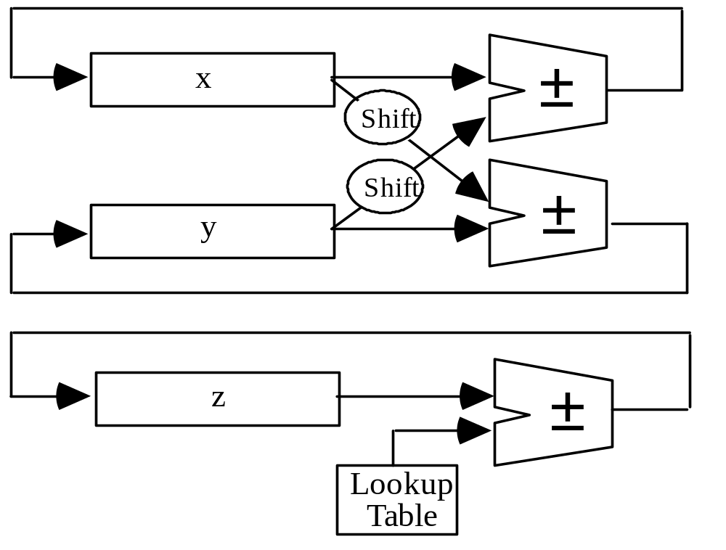
22.3 CORDIC Hardware
x^{(i+1)} = x^{(i)} – d_{i} y^{(i)} 2^{–i}
y^{(i+1)} = y^{(i)} + d_{i} x^{(i)} 2^{–i}
z^{(i+1)} = z^{(i)} – d_{i} tan ^{–1} 2^{–i}
= z^{(i)} – d_{i} e^{(i)}
If very high speed is not needed (as in a calculator), a single adder and one shifter would suffice
k table entries for
k bits of precision
Fig. 22.3 Hardware elements needed for the CORDIC method.

Slide 42
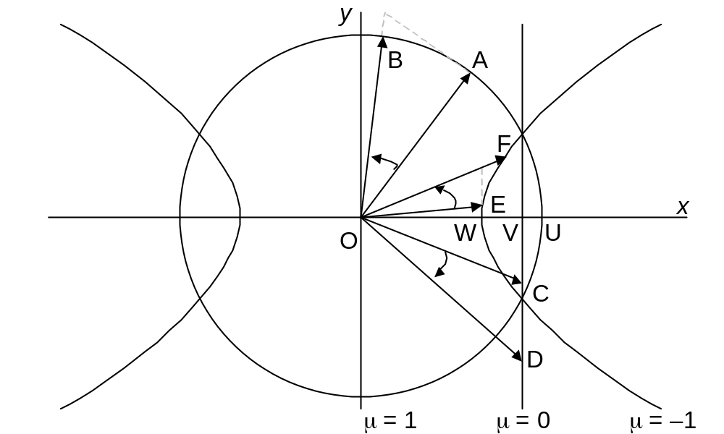
22.4 Generalized CORDIC
x^{(i+1)} = x^{(i)} – μ d_{i} y^{(i)} 2^{–i}
y^{(i+1)} = y^{(i)} + d_{i} x^{(i)} 2^{–i}
z^{(i+1)} = z^{(i)} – d_{i} e^{(i)}
μ = 1 Circular rotations
(basic CORDIC) e^{(i)} = tan ^{–1} 2^{–i}
μ = 0 Linear rotations
e^{(i)} = 2^{–i}
μ = –1 Hyperbolic rotations e^{(i)} = tanh ^{–1} 2^{–i}
Fig. 22.4 Circular, linear, and hyperbolic CORDIC.

Slide 43
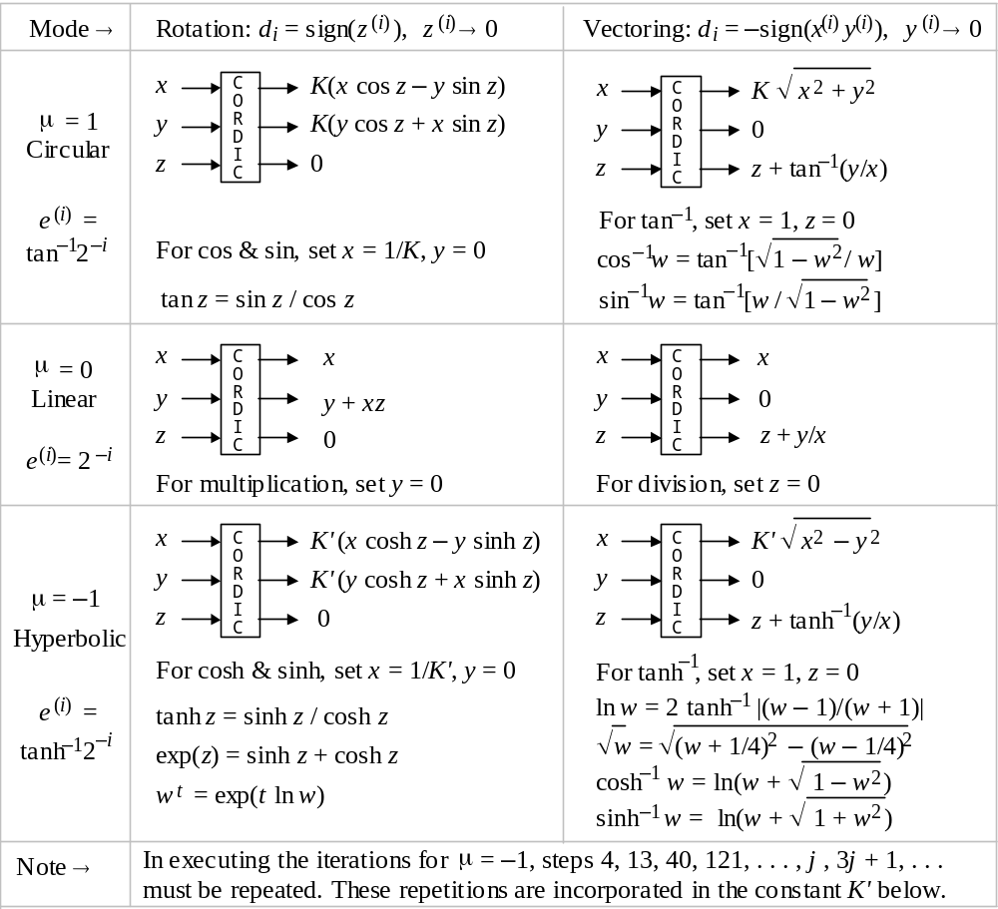
22.5 Using the CORDIC Method
x^{(i+1)} = x^{(i)} – μ d_{i} y^{(i)} 2^{–i}
y^{(i+1)} = y^{(i)} + d_{i} x^{(i)} 2^{–i}
z^{(i+1)} = z^{(i)} – d_{i} e^{(i)}
μ ∈ {–1, 0, 1}
d_{i} ∈ {–1, 1}
K = 1.646 760 258 121 ...
1/K = .607 252 935 009 ...
K' = .828 159 360 960 2 ...
1/K' = 1.207 497 067 763 ...
Fig. 22.5 Summary of generalized CORDIC algorithms.

Slide 44
CORDIC Speedup Methods
x^{(i+1)} = x^{(i)} – μ d_{i} y^{(i)} 2^{–i}
y^{(i+1)} = y^{(i)} + d_{i} x^{(i)} 2^{–i}
z^{(i+1)} = z^{(i)} – d_{i} e^{(i)}
Skipping some rotations
Must keep track of expansion via the recurrence:
(K^{(i+1)})² = (K^{(i)})² (1 ± 2^{–2i})
This additional work makes variable-factor CORDIC less cost-effective than constant-factor CORDIC
x^{(k)} = x^{(k/2)} – y^{(k/2)} z^{(k/2)}
y^{(k)} = y^{(i)} + x^{(k/2)} z^{(k/2)} z^{(k)} = z^{(k/2)} – z^{(k/2)}
Early termination
Do the first k/2 iterations as usual, then combine
the remaining k/2 into a single multiplicative step:
For very small z, we have tan^{–1} z ≅ z ≅ tan z
Expansion factor not an issue because contribution of the ignored terms is provably less than ulp
d_{i} ∈ {–2, –1, 1, 2} or
{–2, –1, 0, 1, 2}
High-radix CORDIC
The hardware for the radix-4 version of CORDIC is quite similar to Fig. 22.3

Slide 45
22.6 An Algebraic Formulation
Because
cos z + j sin z = e ^{jz} where j = √–1
cos z and sin z can be computed via evaluating the complex exponential function e ^{jz}
This leads to an alternate derivation of CORDIC iterations
Details in the text

Slide 46
23 Variations in Function Evaluation
Chapter Goals
Learning alternate computation methods
(convergence and otherwise) for some
functions computable through CORDIC
Chapter Highlights
Reasons for needing alternate methods:
Achieve higher performance or precision
Allow speed/cost tradeoffs
Optimizations, fit to diverse technologies

Slide 47
Variations in Function Evaluation: Topics
Topics in This Chapter
23.1. Additive / Multiplicative Normalization
23.2. Computing Logarithms
23.3. Exponentiation
23.4. Division and Square-Rooting, Again
23.5. Use of Approximating Functions
23.6. Merged Arithmetic

Slide 48
23.1 Additive / Multiplicative Normalization
u ^{(i+1)} = f(u ^{(i)}, v ^{(i)})
v ^{(i+1)} = g(u ^{(i)}, v ^{(i)})
Constant
u ^{(i+1)} = f(u ^{(i)}, v ^{(i)}, w ^{(i)})
v ^{(i+1)} = g(u ^{(i)}, v ^{(i)}, w ^{(i)})
w ^{(i+1)} = h(u ^{(i)}, v ^{(i)}, w ^{(i)})
Desired
function
Guide the iteration such that one of the values converges to a constant (usually 0 or 1); this is known as normalization
The other value then converges to the desired function
Additive normalization: Normalize u via addition of terms to it
Multiplicative normalization: Normalize u via multiplication of terms
Additive normalization is more desirable, unless the multiplicative terms are of the form 1 ± 2ª (shift-add) or multiplication leads to much faster convergence compared with addition

Slide 49
Convergence Methods You Already Know
x^{(i+1)} = x^{(i)} – μ d_{i} y^{(i)} 2^{–i}
y^{(i+1)} = y^{(i)} + d_{i} x^{(i)} 2^{–i}
z^{(i+1)} = z^{(i)} – d_{i} e^{(i)}
CORDIC
Example of additive normalization
Force y or z to 0 by
adding terms to it
Force d to 1 by
multiplying terms with it
d ^{(i+1)} = d ^{(i)} (2 − d ^{(i)}) Set d ⁽⁰⁾ = d; iterate until d ^{(m)} ≅ 1
z ^{(i+1)} = z ^{(i)} (2 − d ^{(i)}) Set z ⁽⁰⁾ = z; obtain z/d = q ≅ z ^{(m)}
Division by repeated multiplications
Example of multiplicative normalization

Slide 50
23.2 Computing Logarithms
d_{i} ∈ {−1, 0, 1}
x ^{(i+1)} = x ^{(i)} c ^{(i)} = x ^{(i)} (1 + d_{i} 2^{–i})
y ^{(i+1)} = y ^{(i)} – ln c ^{(i)} = y ^{(i)} – ln(1 + d_{i} 2^{–i})
Force x ^{(m)} to 1
y ^{(m)} converges to y + ln x
0
Read out from table
Why does this multiplicative normalization method work?
x ^{(m)} = x ∏c ^{(i)} ≅ 1 ⇒ ∏c ^{(i)} ≅ 1/x
y ^{(m)} = y – ∑ ln c ^{(i)} = y – ln (∏c ^{(i)}) = y – ln(1/x) ≅ y + ln x
Convergence domain: 1/∏(1 + 2^{–i}) ≤ x ≤ 1/∏(1 – 2^{–i}) or 0.21 ≤ x ≤ 3.45
Number of iterations: k, for k bits of precision; for large i, ln(1 ± 2^{–i}) ≅ ± 2^{–i}
Use directly for x ∈ [1, 2). For x = 2^{q} s, we have:
ln x = q ln 2 + ln s = 0.693 147 180 q + ln s
Radix-4 version can be devised

Slide 51
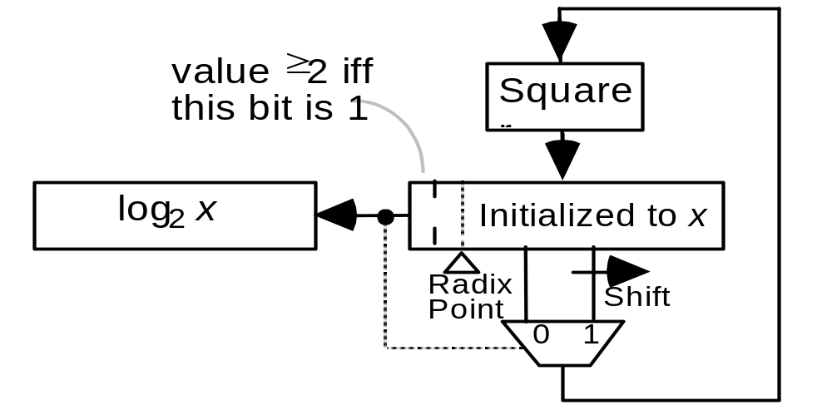
Computing Binary Logarithms via Squaring
For x ∈ [1, 2), log₂ x is a fractional number y = (. y_{–1}y_{–2}y_{–3} . . . y_{–l})_{two}
x = 2^{y} = 2
x ² = 2^{2y} = 2 ⇒ y_{–1} = 1 iff x ² ≥ 2
(. y_{–1}y_{–2}y_{–3} . . . y_{–l})_{two}
(y_{–1}. y_{–2}y_{–3} . . . y_{–l})_{two}
Once y_{–1} has been determined, if y_{–1} = 0, we are back at the original situation; otherwise, divide both sides of the equation above by 2 to get:
x ²/2 = 2 /2 = 2
(1 . y_{–2}y_{–3} . . . y_{–l})_{two}
(. y_{–2}y_{–3} . . . y_{–l})_{two}
Generalization to base b:
x = b
y_{–1} = 1 iff x ² ≥ b
(. y_{–1}y_{–2}y_{–3} . . . y_{–l})_{two}
Fig. 23.1 Hardware elements needed for computing log₂ x.

Slide 52
23.3 Exponentiation
Computing e^{x}
Read out from table
x ^{(i+1)} = x ^{(i)} – ln c ^{(i)} = x ^{(i)} – ln(1 + d_{i} 2^{–i})
y ^{(i+1)} = y ^{(i)} c ^{(i)} = y ^{(i)} (1 + d_{i} 2^{–i})
Force x ^{(m)} to 0
y ^{(m)} converges to y e^{x}
1
d_{i} ∈ {−1, 0, 1}
Why does this additive normalization method work?
x ^{(m)} = x – ∑ ln c ^{(i)} ≅ 0 ⇒ ∑ ln c ^{(i)} ≅ x
y ^{(m)} = y ∏c ^{(i)} = y exp(ln ∏c ^{(i)}) = y exp(∑ ln c ^{(i)}) ≅ y e^{x}
Convergence domain: ∑ ln (1 – 2^{–i}) ≤ x ≤ ∑ ln (1 + 2^{–i}) or –1.24 ≤ x ≤ 1.56
Number of iterations: k, for k bits of precision; for large i, ln(1 ± 2^{–i}) ≅ ± 2^{–i}
Can eliminate half the iterations because
ln(1 + ε) = ε – ε²/2 + ε³/3 – . . . ≅ ε for ε² < ulp
and we may write y ^{(k)} = y ^{(k/2)} (1 + x ^{(k/2)})
Radix-4 version can be devised

Slide 53
General Exponentiation, or Computing x^{y}
x ^{y} = (e ^{ln x}) ^{y} = e ^{y ln x} So, compute natural log, multiply, exponentiate
When y is an integer, we can exponentiate by repeated multiplication (need to consider only positive y; for negative y, compute reciprocal)
In particular, when y is a constant, the methods used are reminiscent of multiplication by constants (Section 9.5)
Example: x ²⁵ = ((((x)²x)²)²)²x [4 squarings and 2 multiplications]
Noting that 25 = (1 1 0 0 1)_{two}, leads to a general procedure
Computing x ^{y}, when y is an unsigned integer
Initialize the partial result to 1
Scan the binary representation of y, starting at its MSB, and repeat
If the current bit is 1, multiply the partial result by x
If the current bit is 0, do not change the partial result
Square the partial result before the next step (if any)

Slide 54
Faster Exponentiation via Recoding
Example: x ³¹ = ((((x)²x)²x)²x)²x [4 squarings and 4 multiplications]
Note that 31 = (1 1 1 1 1)_{two} = (1 0 0 0 0⁻1)_{two}
x ³¹ = (((((x)²)²)²)²)² / x [5 squarings and 1 division]
Computing x ^{y}, when y is an integer encoded in BSD format
Initialize the partial result to 1
Scan the binary representation of y, starting at its MSB, and repeat
If the current digit is 1, multiply the partial result by x
If the current digit is 0, do not change the partial result
If the current digit is ⁻1, divide the partial result by x
Square the partial result before the next step (if any)
Radix-4 example: 31 = (1 1 1 1 1)_{two} = (1 0 0 0 0⁻1)_{two} = (2 0 ⁻1)_{four}
x ³¹ = (((x²)⁴)⁴ / x [Can you formulate the general procedure?]

Slide 55
23.4 Division and Square-Rooting, Again
Computing q = z / d
In digit-recurrence division, γ ^{(i)} is the next quotient digit and the addition for q turns into concatenation; more generally, γ ^{(i)} can be any estimate for the difference between the partial quotient q ^{(i)} and the final quotient q
s ^{(i+1)} = s ^{(i)} – γ ^{(i)} d
q ^{(i+1)} = q ^{(i)} + γ ^{(i)}
Because s ^{(i)} becomes successively smaller as it converges to 0, scaled versions of the recurrences above are usually preferred.
In the following, s ^{(i)} stands for s ^{(i)} r ^{i} and q ^{(i)} for q ^{(i)} r ^{i} :
s ^{(i+1)} = rs ^{(i)} – γ ^{(i)} d Set s ⁽⁰⁾ = z and keep s ^{(i)} bounded
q ^{(i+1)} = rq ^{(i)} + γ ^{(i)} Set q ⁽⁰⁾ = 0 and find q * = q ^{(m)} r ^{–m}
In the scaled version, γ ^{(i)} is an estimate for r (r ^{i–m} q – q ^{(i)}) = r (r ^{i} q * - q ^{(i)}), where q * = r ^{–m} q represents the true quotient

Slide 56
Square-Rooting via Multiplicative Normalization
Idea: If z is multiplied by a sequence of values (c ^{(i)})², chosen so that the product z ∏(c ^{(i)})² converges to 1, then z ∏c ^{(i)} converges to √z
x ^{(i+1)} = x ^{(i)} (1 + d_{i} 2^{–i})² = x ^{(i)} (1 + 2d_{i} 2^{–i} + d_{i}² 2^{–2i}) x ⁽⁰⁾ = z, x ^{(m)} ≅ 1
y ^{(i+1)} = y ^{(i)} (1 + d_{i} 2^{–i}) y ⁽⁰⁾ = z, y ^{(m)} ≅ √z
What remains is to devise a scheme for choosing d_{i} values in {–1, 0, 1}
d_{i} = 1 for x ^{(i)} < 1 – ε = 1 – α2^{–i} d_{i} = –1 for x ^{(i)} > 1 + ε = 1 + α2^{–i}
To avoid the need for comparison with a different constant in each step,
a scaled version of the first recurrence is used in which u ^{(i)} = 2^{i} (x ^{(i)} – 1):
u ^{(i+1)} = 2(u ^{(i)} + 2d_{i}) + 2^{–i+1}(2d_{i} u ^{(i)} + d_{i}²) + 2^{–2i+1}d_{i}² u ^{(i)} u ⁽⁰⁾ = z – 1, u ^{(m)} ≅ 0
y ^{(i+1)} = y ^{(i)} (1 + d_{i} 2^{–i}) y ⁽⁰⁾ = z, y ^{(m)} ≅ √z
Radix-4 version can be devised: Digit set [–2, 2] or {–1, –½, 0, ½, 1}

Slide 57
Square-Rooting via Additive Normalization
Idea: If a sequence of values c ^{(i)} can be obtained such that z – (∑c ^{(i)})² converges to 0, then ∑ c ^{(i)} converges to √z
x ^{(i+1)} = z – (y ^{(i+1)})² = z – (y ^{(i)} + c ^{(i)})² = x ^{(i)} + 2d_{i} y ^{(i)} 2^{–i} – d_{i}² 2^{–2i} x ⁽⁰⁾ = z, x ^{(m)} ≅ 0
y ^{(i+1)} = y ^{(i)} + c ^{(i)} = y ^{(i)} – d_{i} 2^{–i} y ⁽⁰⁾ = 0, y ^{(m)} ≅ √z
What remains is to devise a scheme for choosing d_{i} values in {–1, 0, 1}
d_{i} = 1 for x ^{(i)} < – ε = – α2^{–i} d_{i} = –1 for x ^{(i)} > + ε = + α2^{–i}
To avoid the need for comparison with a different constant in each step,
a scaled version of the first recurrence may be used in which u ^{(i)} = 2^{i} x ^{(i)}:
u ^{(i+1)} = 2(u ^{(i)} + 2d_{i} y ^{(i)} – d_{i}² 2^{–i} ) u ⁽⁰⁾ = z , u ^{(i)} bounded
y ^{(i+1)} = y ^{(i)} – d_{i} 2^{–i} y ⁽⁰⁾ = 0, y ^{(m)} ≅ √z
Radix-4 version can be devised: Digit set [–2, 2] or {–1, –½, 0, ½, 1}

Slide 58
23.5 Use of Approximating Functions
Convert the problem of evaluating the function f to that of function g approximating f, perhaps with a few pre- and postprocessing operations
Approximating polynomials need only additions and multiplications
Polynomial approximations can be derived from various schemes
The Taylor-series expansion of f(x) about x = a is
f(x) = ∑ _{j=0 to ∞} f ^{(j)} (a) (x – a) ^{j} / j!
The error due to omitting terms of degree > m is:
f ^{(m+1)} (a + μ(x – a)) (x – a)^{m+1} / (m + 1)! 0 < μ < 1
Setting a = 0 yields the Maclaurin-series expansion
f(x) = ∑ _{j=0 to ∞} f ^{(j)} (0) x ^{j} / j!
and its corresponding error bound:
f ^{(m+1)} (μx) x^{m+1} / (m + 1)! 0 < μ < 1
Efficiency in computation can be gained via Horner’s method and incremental evaluation

Slide 59
Some Polynomial Approximations (Table 23.1)
–––––––––––––––––––––––––––––––––––––––––––––––––––––––––––
Func Polynomial approximation Conditions
–––––––––––––––––––––––––––––––––––––––––––––––––––––––––––
1/x 1 + y + y ² + y ³ + . . . + y ^{i} + . . . 0 < x < 2, y = 1 – x
e^{x} 1 + x /1! + x ²/2! + x ³/3! + . . . + x ^{i} /i ! + . . .
ln x –y – y ²/2 – y ³/3 – y ⁴/4 – . . . – y ^{i} /i – . . . 0 < x ≤ 2, y = 1 – x
ln x 2 [z + z ³/3 + z ⁵/5 + . . . + z ^{2i+1}/(2i + 1) + . . . ] x > 0, z = ^{x–1}_{x+1}
sin x x – x ³/3! + x ⁵/5! – x ⁷/7! + . . . + (–1)^{i} x^{2i+1}/(2i + 1)! + . . .
cos x 1 – x ²/2! + x ⁴/4! – x ⁶/6! + . . . + (–1)^{i} x^{2i} /(2i )! + . . .
tan^{–1} x x – x ³/3 + x ⁵/5 – x ⁷/7 + . . . + (–1)^{i} x^{2i+1}/(2i + 1) + . . . –1 < x < 1
sinh x x + x ³/3! + x ⁵/5! + x ⁷/7! + . . . + x^{2i+1}/(2i + 1)! + . . .
cosh x 1 + x ²/2! + x ⁴/4! + x ⁶/6! + . . . + x^{2i} /(2i )! + . . .
tanh^{–1}x x + x ³/3 + x ⁵/5 + x ⁷/7 + . . . + x^{2i+1}/(2i + 1) + . . . –1 < x < 1
–––––––––––––––––––––––––––––––––––––––––––––––––––––––––––

Slide 60
Function Evaluation via Divide-and-Conquer
Let x in [0, 4) be the (l + 2)-bit significand of a floating-point number or its shifted version. Divide x into two chunks x _{H} and x _{L}:
x = x _{H} + 2^{–t} x _{L}
0 ≤ x _{H} < 4 t + 2 bits
0 ≤ x _{L} < 1 l – t bits
t bits
x _{H} in [0, 4)
x _{L} in [0, 1)
The Taylor-series expansion of f(x) about x = x _{H} is
f(x) = ∑ _{j=0 to ∞} f ^{(j)} (x _{H}) (2^{–t} x _{L}) ^{j} / j!
A linear approximation is obtained by taking only the first two terms
f(x) ≅ f (x _{H}) + 2^{–t} x _{L} f′ (x _{H})
If t is not too large, f and/or f′ (and other derivatives of f, if needed) can be evaluated via table lookup

Slide 61
Approximation by the Ratio of Two Polynomials
Example, yielding good results for many elementary functions
f(x) ≅
Using Horner’s method, such a “rational approximation” needs 10 multiplications, 10 additions, and 1 division

Slide 62
23.6 Merged Arithmetic
Our methods thus far rely on word-level building-block operations such as addition, multiplication, shifting, . . .
Sometimes, we can compute a function of interest directly without breaking it down into conventional operations
Example: merged arithmetic for inner product computation
z = z ⁽⁰⁾ + x ⁽¹⁾ y ⁽¹⁾ + x ⁽²⁾ y ⁽²⁾ + x ⁽³⁾ y ⁽³⁾
• • • • • • • •
• • • •
• • • •
• • • •
• • • •
• • • •
• • • •
• • • •
• • • •
• • • •
• • • •
• • • •
• • • •
z⁽⁰⁾
x⁽¹⁾ y⁽¹⁾
x⁽²⁾ y⁽²⁾
Fig. 23.2 Merged-arithmetic computation of an inner product followed by accumulation.
x⁽³⁾ y⁽³⁾

Slide 63
Example of Merged Arithmetic Implementation
Example: Inner product computation
z = z ⁽⁰⁾ + x ⁽¹⁾ y ⁽¹⁾ + x ⁽²⁾ y ⁽²⁾ + x ⁽³⁾ y ⁽³⁾
• • • • • • • •
• • • •
• • • •
• • • •
• • • •
• • • •
• • • •
• • • •
• • • •
• • • •
• • • •
• • • •
• • • •
z⁽⁰⁾
x⁽¹⁾ y⁽¹⁾
Fig. 23.2
x⁽²⁾ y⁽²⁾
Fig. 23.3 Tabular representation of the dot matrix for inner-product computation and its reduction.
x⁽³⁾ y⁽³⁾
1 4 7 10 13 10 7 4 16 FAs
2 4 6 8 8 6 4 2 10 FAs + 1 HA
3 4 4 6 6 3 3 1 9 FAs
1 2 3 4 4 3 2 1 1 4 FAs + 1 HA
1 3 2 3 3 2 1 1 1 3 FAs + 2 HAs
2 2 2 2 2 1 1 1 1 5-bit CPA

Slide 64
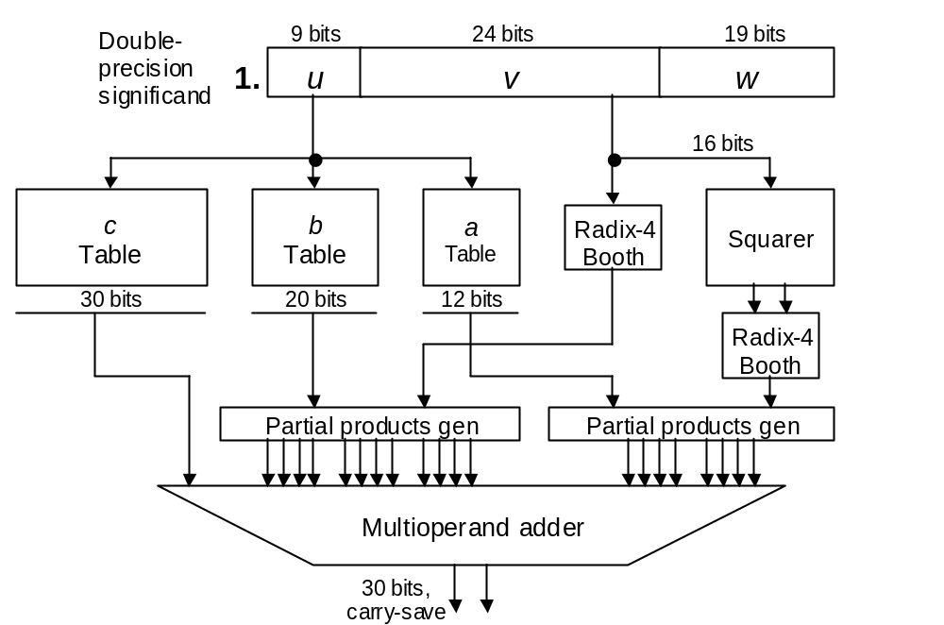
Another Merged Arithmetic Example
Approximation of reciprocal (1/x) and reciprocal square root (1/√x) functions with 29-30 bits of precision, so that a long floating-point result can be obtained with just one iteration at the end [Pine02]
f(x) = c + bv + av ²
2 adds
2 mult’s
1 square
Comparable
to a multiplier

Slide 65
24 Arithmetic by Table Lookup
Chapter Goals
Learning table lookup techniques
for flexible and dense VLSI realization
of arithmetic functions
Chapter Highlights
We have used tables to simplify or speedup
q digit selection, convergence methods, . . .
Now come tables as primary computational
mechanisms (as stars, not supporting cast)

Slide 66
Arithmetic by Table Lookup: Topics
Topics in This Chapter
24.1. Direct and Indirect Table Lookup
24.2. Binary-to-Unary Reduction
24.3. Tables in Bit-Serial Arithmetic
24.4. Interpolating Memory
24.5. Tradeoffs in Cost, Speed, and Accuracy
24.6. Piecewise Lookup Tables

Slide 67
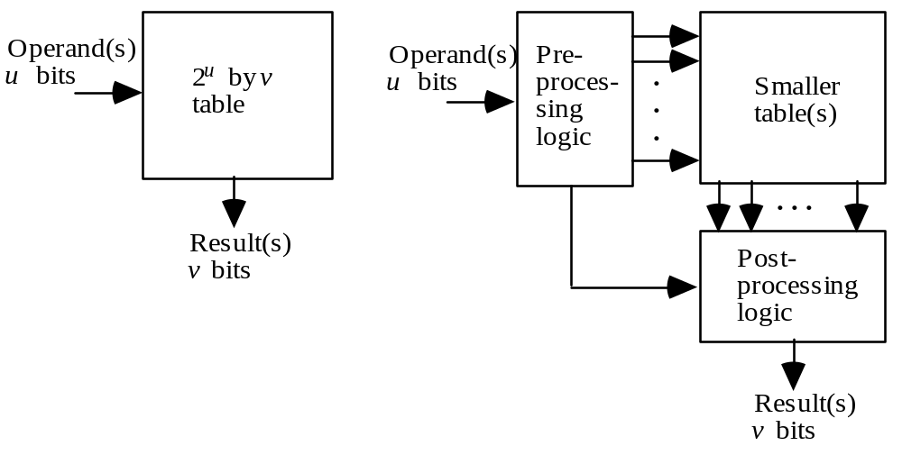
24.1 Direct and Indirect Table Lookup
Fig. 24.1 Direct table lookup versus
table-lookup with pre- and post-processing.

Slide 68
Tables in Supporting and Primary Roles
Tables are used in two ways:
In supporting role, as in initial estimate for division
As main computing mechanism
Boundary between two uses is fuzzy
Pure logic Hybrid solutions Pure tabular
Previously, we started with the goal of designing logic circuits for particular arithmetic computations and ended up using tables to facilitate or speed up certain steps
Here, we aim for a tabular implementation and end up using peripheral logic circuits to reduce the table size
Some solutions can be derived starting at either endpoint

Slide 69
24.2 Binary-to-Unary Reduction
Strategy: Reduce the table size by using an auxiliary unary function to evaluate a desired binary function
Example 1: Addition/subtraction in a logarithmic number system; i.e., finding Lz = log(x ± y), given Lx and Ly
Solution: Let Δ = Ly – Lx
Lz = log(x ± y)
= log(x (1 ± y/x))
= log x + log(1 ± y/x)
= Lx + log(1 ± log ^{–1}Δ)
Ly
Δ = Ly – Lx
Pre-process
Lx
φ⁺ table
φ⁻ table
Post-process
Lz
Lx + φ⁺(Δ)
Lx + φ⁻(Δ)

Slide 70
Another Example of Binary-to-Unary Reduction
Example 2: Multiplication via squaring, xy = (x + y)²/4 – (x – y)²/4
Simplification and implementation details
If x and y are k bits wide,
x + y and x – y are k + 1
bits wide, leading to two
tables of size 2^{k+1} × 2k
(total table size = 2^{k+3} × k bits)
(x ± y)/2 = ⎣(x ± y)/2⎦ + ε/2 ε ∈ {0, 1} is the LSB
(x + y)²/4 – (x – y)²/4
= [ ⎣(x + y)/2⎦ + ε/2] ² – [ ⎣(x – y)/2⎦ + ε/2] ²
= ⎣(x + y)/2⎦ ² – ⎣(x – y)/2⎦ ² + εy
Pre-process: compute x + y and x – y; drop their LSBs
Table lookup: consult two squaring table(s) of size 2^{k} × (2k – 1)
Post-process: carry-save adder, followed by carry-propagate adder
(table size after simplification = 2^{k+1} × (2k – 1) ≅ 2^{k+2} × k bits)
x
x + y
Pre-process
y
x – y
Square table
Square table
Post-process
xy

Slide 71
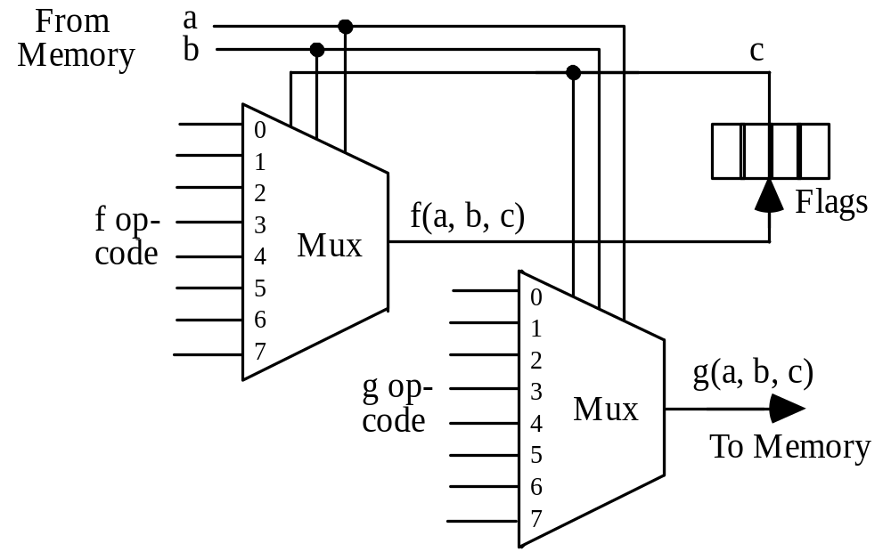
24.3 Tables in Bit-Serial Arithmetic
Specified by
16-bit addresses
Specified by 2-bit address
(64 Kb)
3 bits specify a flag and a value to conditionalize the operation
0
0
0
1
0
1
1
1
8-bit opcode
(f truth table)
Specified by 2-bit address
0
1
0
1
0
1
0
1
Carry bit
for addition
Replaces a in memory
8-bit opcode
(g truth table)
Fig. 24.2 Bit-serial ALU with two tables implemented as multiplexers.
Used in Connection Machine 2,
an MPP introduced in 1987
Sum bit
for addition

Slide 72
Second-Order Digital Filter: Definition
x ^{(i+1)}
y ^{(i)} = a⁽⁰⁾x ^{(i)} + a⁽¹⁾x ^{(i–1)} + a⁽²⁾x ^{(i–2)} – b⁽¹⁾y ^{(i–1)} – b⁽²⁾y ^{(i–2)}
x ^{(i)}
a^{(j)}s and b^{(j)}s are constants
.
.
.
x ⁽³⁾
Current and two previous inputs
Two previous outputs
x ⁽²⁾
x ⁽¹⁾
Expand the equation for y ^{(i)} in terms of the bits in operands
x = (x₀.x_{–1}x_{–2} . . . x_{–l} )_{2’s-compl} and y = (y₀.y_{–1}y_{–2} . . . y_{–l} )_{2’s-compl} ,
where the summations range from j = – l to j = –1
y ^{(i)} = a⁽⁰⁾(–x₀^{(i)} + ∑2^{j} x_{j}^{(i)})
+ a⁽¹⁾(–x₀^{(i−1)} + ∑2^{j} x_{j}^{(i−1)}) + a⁽²⁾(–x₀^{(i−2)} + ∑2^{j} x_{j}^{(i−2)})
– b⁽¹⁾(–y₀^{(i−1)} + ∑2^{j} y_{j}^{(i−1)}) – b⁽²⁾(–y₀^{(i−2)} + ∑2^{j} y_{j}^{(i−2)})
Filter
Latch
y ^{(i)}
.
.
.
y ⁽³⁾
y ⁽²⁾
y ⁽¹⁾
Define f(s, t, u, v, w) = a⁽⁰⁾s + a⁽¹⁾t + a⁽²⁾u – b⁽¹⁾v – b⁽²⁾w
y ^{(i)} = ∑2^{j} f(x_{j}^{(i)}, x_{j}^{(i−1)}, x_{j}^{(i−2)}, y_{j}^{(i−1)}, y_{j}^{(i−2)}) – f(x₀^{(i)}, x₀^{(i−1)}, x₀^{(i−2)}, y₀^{(i−1)}, y₀^{(i−2)})

Slide 73
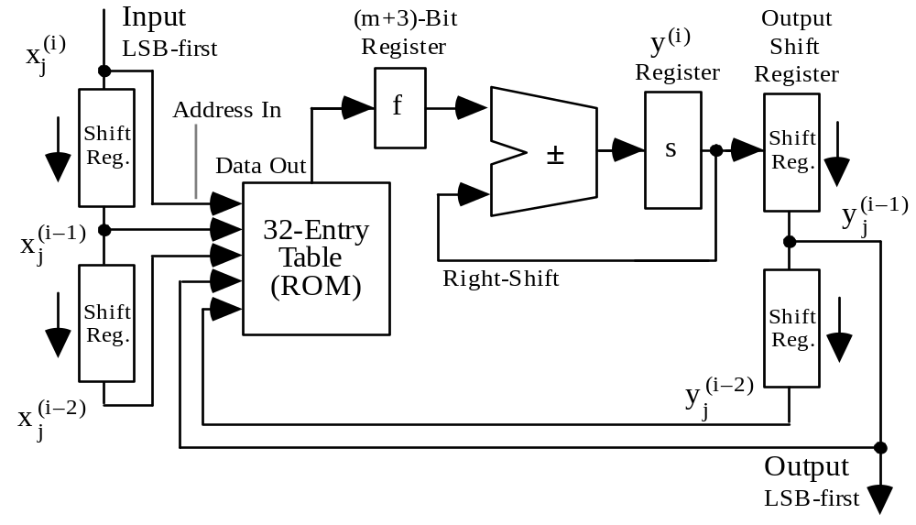
Second-Order Digital Filter: Bit-Serial Implementation
i th output being formed
i th input
(i – 1) th output
(i – 1) th input
(i – 2) th input
Copy at the end of cycle
(i – 2) th output
Fig. 20.5 Bit-serial tabular realization of a second-order filter.

Slide 74
24.4 Interpolating Memory
Linear interpolation: Computing f(x), x ∈ [x_{lo}, x_{hi}], from f(x_{lo}) and f(x_{hi})
x – x_{lo}
f (x) = f (x_{lo}) + [ f (x_{hi}) – f (x_{lo}) ] 4 adds, 1 divide, 1 multiply
x_{hi} – x_{lo}
If the x_{lo} and x_{hi} endpoints are consecutive multiples of a power of 2,
the division and two of the additions become trivial
Example: Evaluating log₂ x for x ∈ [1, 2)
f(x_{lo}) = log₂ 1 = 0, f(x_{hi}) = log₂ 2 = 1; thus:
log₂ x ≅ x – 1 = Fractional part of x
An improved linear interpolation formula
ln 2 – ln(ln 2) – 1
log₂ x ≅ + (x – 1) = 0.043 036 + Δx
2 ln 2
1
0
1
2

Slide 75
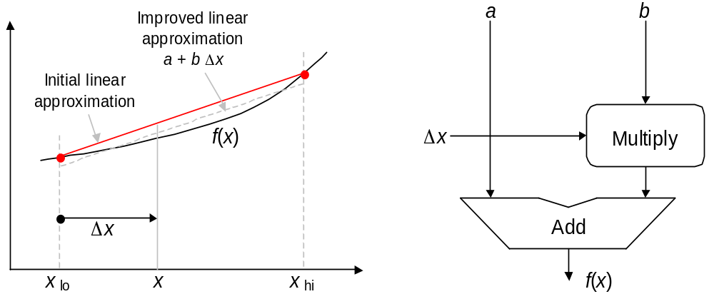
Hardware Linear Interpolation Scheme
Fig. 24.4 Linear interpolation for computing f(x) and its hardware realization.

Slide 76
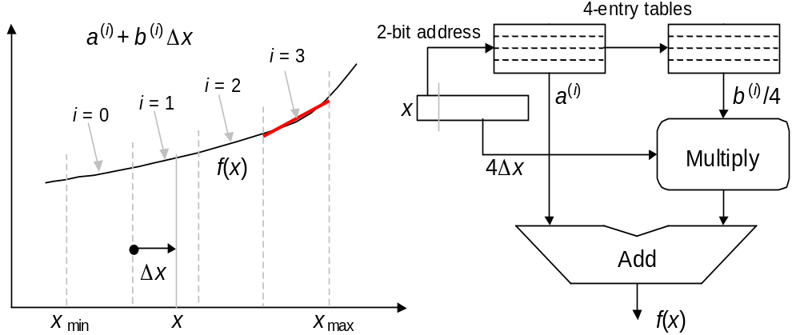
Linear Interpolation with Four Subintervals
Fig. 24.5 Linear interpolation for computing f(x) using 4 subintervals.
Table 24.1 Approximating log₂ x for x in
[1, 2) using linear interpolation within 4 subintervals.
––––––––––––––––––––––––––––––––––––––––––––––––
i x_{lo} x_{hi} a ^{(i)} b ^{(i)}/4 Max error
––––––––––––––––––––––––––––––––––––––––––––––––
0 1.00 1.25 0.004 487 0.321 928 ± 0.004 487
1 1.25 1.50 0.324 924 0.263 034 ± 0.002 996
2 1.50 1.75 0.587 105 0.222 392 ± 0.002 142
3 1.75 2.00 0.808 962 0.192 645 ± 0.001 607
––––––––––––––––––––––––––––––––––––––––––––––––

Slide 77
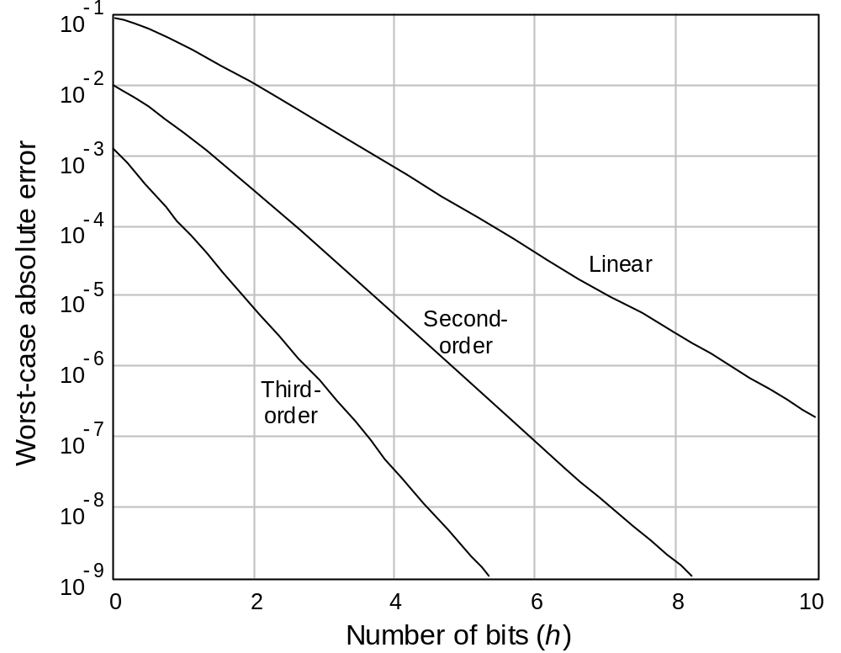
24.5 Tradeoffs in Cost, Speed, and Accuracy
Fig. 24.6 Maximum absolute error in computing log₂ x as a function of number h of address bits for the tables with linear, quadratic (second-degree), and cubic
(third-degree) interpolations [Noet89].

Slide 78
24.6 Piecewise Lookup Tables
To compute a function of a short (single) IEEE floating-point number:
Divide the 26-bit significand x (2 whole + 24 fractional bits) into 4 sections
x = t + λu + λ²v + λ³w
= t + 2^{–6}u + 2^{–12}v + 2^{–18}w
where u, v, w are 6-bit fractions in [0, 1) and t, with up to 8 bits, is in [0, 4)
Taylor polynomial for f(x):
f(x) = ∑_{i=0 to ∞} f ^{(i)} (t + λu) (λ²v + λ³w)^{i} / i !
Ignore terms smaller than λ⁵ = 2^{–30}
f(x) ≅ f(t + λu)
+ (λ/2) [f(t + λu + λv) – f(t + λu – λv)]
+ (λ²/2) [f(t + λu + λw) – f(t + λu – λw)]
+ λ⁴ [(v ²/2) f ⁽²⁾(t) – (v ³/6) f ⁽³⁾(t)]
t
u
v
w
Use 4 additions to form these terms
Read 5 values of f from tables
Read this last term from a table
Perform 6-operand addition

Slide 79
Bipartite Lookup Tables for Function Evaluation
Divide the domain of interest into
2^{g} intervals, each of which is further divided into 2^{h} smaller subintervals
Thus, g high-order bits specify an interval, the next h bits specify a subinterval, and k – g – h bits identify a point in the subinterval
The trick: Use linear interpolation with an initial value determined for each subinterval and a common slope for each larger interval
g bits
h bits
k–g–h bits
g + h bits
k – h bits
Table 1
Table 2
2^{g+h} entries
2^{k–h} entries
+
Total table size is 2^{g+h} + 2^{k–h}, in lieu of 2^{k}; width of table entries has been ignored in this comparison
The bipartite table method for function evaluation.

Slide 80
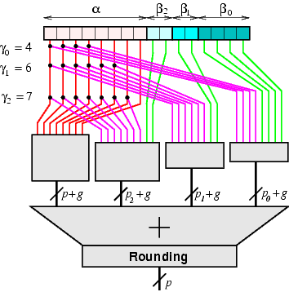
Multipartite Table Lookup Schemes
Two-part tables have been generalized to multipart (3-part,
4-part, . . .) tables
Source of figure: www.ens-lyon.fr/LIP/Arenaire/Ware/Multipartite/

Slide 81
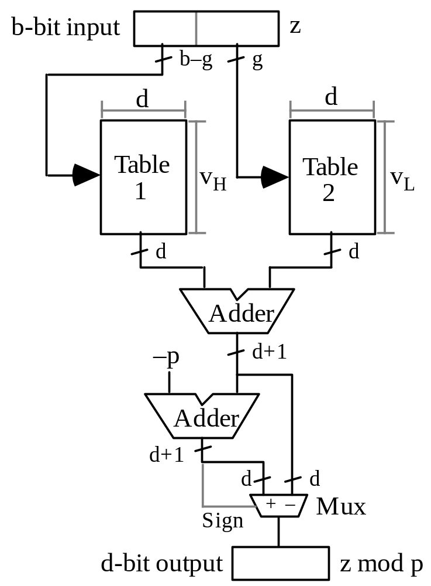
Modular Reduction, or Computing z mod p
Divide the argument z into a (b – g)-bit upper part (x) and a g-bit lower part (y), where x ends with g zeros
(x + y) mod p = (x mod p + y mod p) mod p
Table 24.7 Two-table modular reduction scheme based on divide-and-conquer.

Slide 82
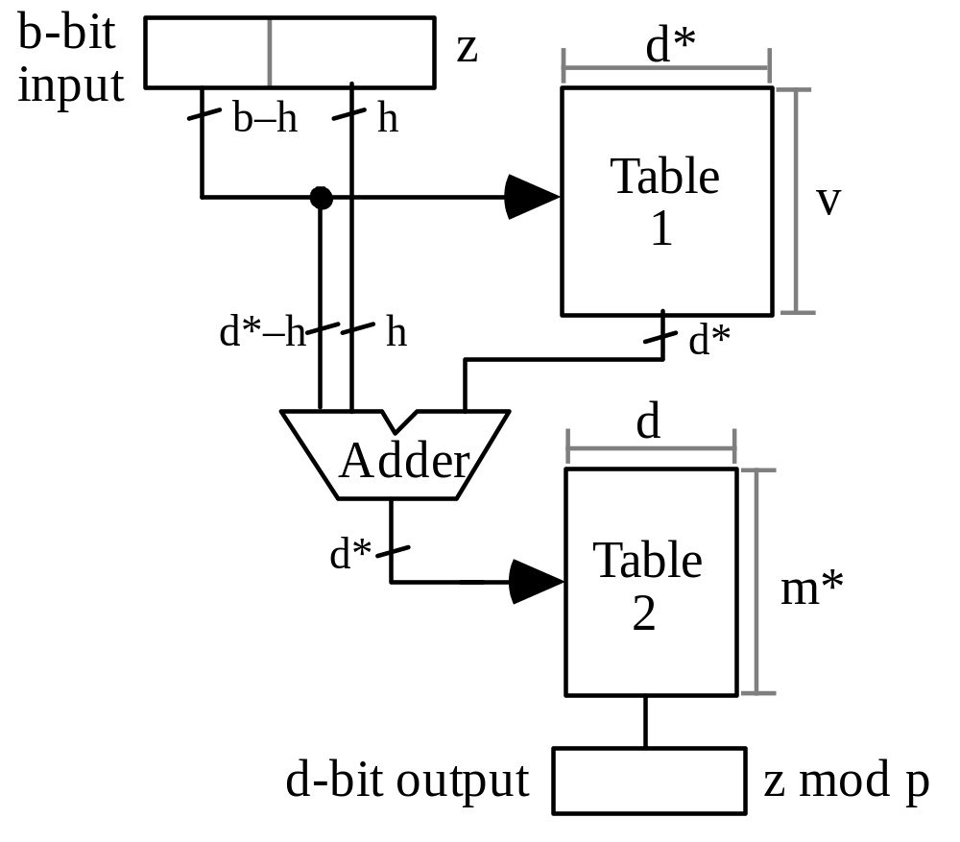
Another Two-Table Modular Reduction Scheme
Divide the argument z into a (b – h)-bit upper part (x) and an h-bit lower part (y), where x ends with h zeros
Explanation to be added
Table 24.8 Modular reduction based on successive refinement.

